Slide 1
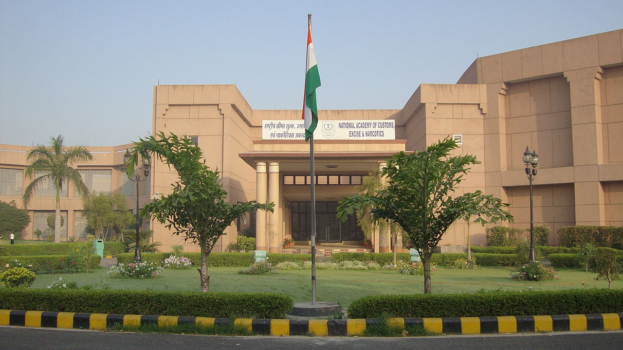
OVER VIEW OF
GST LAW & PROCEDURE
GST Awareness Campaign
Notes:
Why this GST Awareness Campaign? Because GST is going to impact each one of us. The benefits will percolate to all of us and ultimately to country only if all of us strive together to make it a success. We all need to understand the conceptual aspects of GST so as to avoid initial implementation glitches.

Slide 2
Presentation Plan
Introduction: GST A Game Changer
Benefits and Salient Features of GST
Role of Technology
Registration and Returns
IGST Mechanism
Notes:
This is what we would like to cover. GST is not just a tax reform but much more than that. It will change the way businesses are done. GST is going to impact each one of us in one way or other. We will discuss how GST is a win-win situation for all of us as well as for the country as a whole. Salient features. Besides registration and returns are the basic processes core to the functioning of all companies liable to pay tax. Technology is going to be the key enabler and will play a major role in the implementation of GST. Without a discussion on it, the topic will remain incomplete.

Slide 3
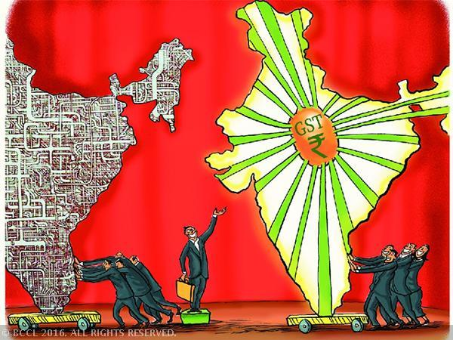
What is GST?
One Tax For
Manufacturing
Trading
Services
ONE NATION: ONE TAX
Notes:
Whether you are manufacturer, trader, dealer, service supplier- all will be considered as same i.e taxpayer. Whether you supply within the same state or anywhere in the country, the rate of tax is same, thereby obviating any need for various forms and border check points which is prevalent today.

Slide 4
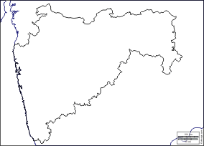
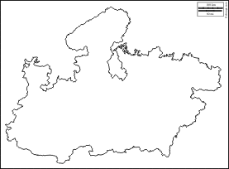

Limitations of current Tax regime
1. Cascading Effect of Tax
MAHARASHTRA
MADHYA PRADESH
Credit of CST Not Available (This should relate to interstate supply. An arrow can be shown from wholesaler in Maharashtra to retailer in Madhya Pradesh and show that credit of CST paid in Mah. not available to Retailer in MP)
Credit of Excise not allowed
Notes:
The present existing tax regime is grossly inefficient with breakage of input tax chain at multiple stages resulting in tax being imposed on tax which is commonly termed as cascade of taxes. All this adds to the costs of a product and results in tendency to avoid paying taxes by using all possible means.

Slide 5
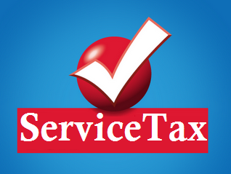



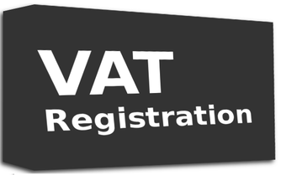


Limitations of current Tax regime :
2. Multiple Registrations
Central Excise
Notes:
Multiple laws require multiple compliances and registrations with no interlinkages amongst them leading to silos being created. In many cases, these different governments- Centre, states are trying to tax same transactions.

Slide 6



Limitations of current Tax regime :
3. Different Points of Taxation
Limitations of current Tax regime :
Central Excise
(On Manufacturing)
Service Tax
(On provision of Service)
VAT
( On sale of Goods)
Notes:
There are different taxable events with each having issues of definitions, interpretations resulting in overlapping at many places. All this creates confusions with many of the issues reaching courts for a decisions.

Slide 7
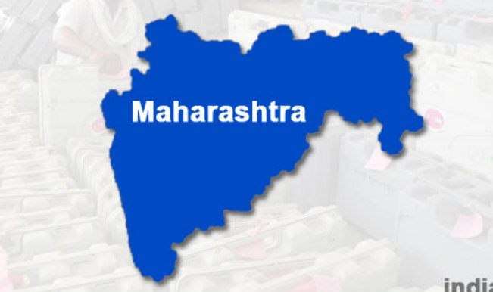
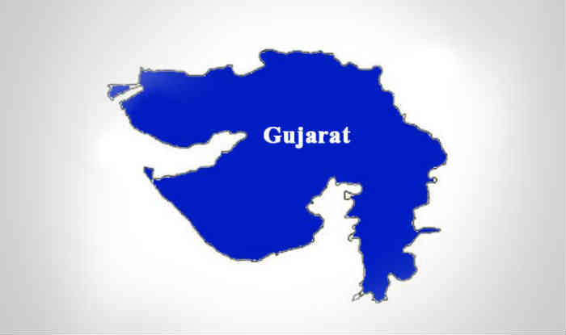
Limitations of current Tax regime :
4. Lack of Uniformity
No Entry Tax
Entry Tax
@ NIL %
@ 4%
Value Added Tax
e.g. on Sugar
Notes:
Harmonisation in the different taxation laws of states appears to be missing many a times. Uniformity is lacking while levying VAT or entry taxes in many states. The companies try to take advantage of tax arbitrages leading to decisions being taken on the basis of tax structure rather than on the basis of pure economic reasons. All this leads to inefficiencies in the system.

Slide 8



Limitations of current Tax regime :
5. Goods Vs. Services dilemma ?
License Software in CD
Sale of Food In Restaurant
Sale
Services
Manufacturing
Notes:
There is a concept of Goods-Service Continuum; If goods and services are places on a scale with pure goods being on one side and services on the other side, most of the transactions lie some where in between having elements of goods as well as service. State government and Centre are in Court in many cases just to decide as regards the classification as goods or services. The distinction between two is getting blurred with the advent of technology. For instance software is being taxed by treating it as services as well as goods. GST appears to be much more efficient tax and may solve most of the existing inefficiencies in indirect taxation system.

Slide 9
Benefits of GST (1/2)
Reduction in Cascading of Taxes
Overall Reduction in Prices
Common National Market
Benefits to Small Taxpayers
Self-Regulating Tax System
Non-Intrusive Electronic Tax System
Decrease in
Inflation
Ease of Doing Business
Decrease in “Black” Transactions
Notes:
GST will be a win-win situation for all. It brings benefits to all the stakeholders of industry, government and the consumer. Being largely technology driven., it will reduce the human interface to a great extent, leading to speedy decisions; increased transparency; decrease in black economy; Self policing system of ITC matching will lead to fair and transparent trade.

Slide 10
Benefits of GST (2/2)
Simplified Tax Regime
Reduction in Multiplicity of Taxes
Consumption Based Tax
Abolition of CST
Exports to be Zero Rated
Protection of Domestic Industry - IGST
More informed consumer
Poorer States
to Gain
Make in India
Notes:
Reduction in multiplicity of taxes will make it simple; Zero rating of exports will ensure competitiveness of exports; Domestic industry will be protected through equivalent taxes being imposed on imports.

Slide 11
Salient features of GST
The GST would be applicable on the supply of goods or services.
It would be a single GST on any item out of which 50% will go to Central Govt and 50% will go to State Govt / Union Territory.
  Central tax (CGST) and State tax (SGST) / Union territory tax (UTGST).
The GST would apply on all goods or services or both other than alcoholic liquor for human consumption and five petroleum products.
Notes:
Centre as well as State shall have concurrent powers to levy GST; Both shall levy GST on common set of registered persons; It will be levied on all goods or services except a very few specified transactions which will be out of the ambit of GST. Alcoholic liquor is out of GST by way of an exclusion in the constitution itself. Petroleum products have been kept out temporarily and will be included in GST at a later date to be decided by GST Council.

Slide 12
Salient features of GST... (contd.)
Destination based consumption tax
  The tax would accrue to the State which has jurisdiction over the place of consumption which is also termed as place of supply.
  Levied at all stages right from manufacture up to final consumption with credit of taxes paid at previous stages available as setoff.
  In a nutshell, only value addition will be taxed and burden of tax is to be borne by the final consumer.
  Exports would be tax-free and imports taxed at the same rate as integrated tax (IGST) levied on inter-State supply of like domestic products
Notes:
This is a very important feature of GST and needs to be understood fully. The consumption tax is a much more efficient tax. The taxes would move with the goods/services along the supply chain to their place of consumption. At every state, only the value added part will be taxed. This will be achieved by way of multi-stage collection mechanism and simultaneously giving credit of taxes paid at the previous stage.

Slide 13
Salient features of GST... (contd.)
Tax payers with an aggregate turnover in a financial year up to Rs.20 lakhs would be exempt from tax.
  For special category states specified in Article 279A, the threshold exemption shall be Rs. 10 lakhs.
  Tax payers making inter-State supplies or paying tax on reverse charge basis shall not be eligible for threshold exemption.
Small taxpayers with an aggregate turnover in a financial year up to Rs. 50 lakhs shall be eligible for composition levy.
Notes:
Small taxpayers need to be relieved as the compliance costs as well as compliance complexities in %age terms may be high for them. Therefore threshold limits for registration have been fixed. Besides, composition scheme has been prescribed for small taxpayers wherein they can pay a small fix % age of their turnover and they do not have to keep detailed compliance documents

Slide 14
Salient features of GST... (contd.)
An Integrated GST (IGST) would be levied and collected by the Centre on inter-State supply of goods and services.
HSN code shall be used for classifying the goods under the GST regime.
Taxpayers whose turnover is above Rs. 1.5 crores but below Rs. 5 crores shall use 2-digit code and the taxpayers whose turnover is Rs. 5 crores and above shall use 4-digit code.
For Services, Service Accounting Codes (SAC) shall be used
Notes:
HSN system of goods classification which is prevalent in Customs as well as Central Excise shall be used for classifying. Most of the goods either emanate from imports or are manufactured. There are already been classified in Central Excise as well as Customs.

Slide 15
Salient features of GST... (contd.)
Exports and Supplies to SEZs shall be treated as zero-rated supply. No tax is payable on exports but ITC related to the supply shall be refunded to exporters.
Import of goods/services would be subject to IGST in addition to Basic Customs duty.
Laws and procedures for levy and collection of CGST/SGST would be harmonized to the extent possible.
Notes:
Zero rating means that there is no duty on the finished goods as well as the taxes paid on the inputs /input services used in the manufacture of such goods are also refunded.

Slide 16
GST Rates
Rates: 0%( on essential items, rice/wheat)
5%: ( on items of mass consumption )
12%/18%:(standard rates covering most manufactured items and Services)
28% : ( on Consumer Durable Goods, Pan masala, tobacco and aerated drinks etc)
Basic philosophy behind these rates are that, to the extent possible, the current combined rate of tax levied on individual goods by the Central and the State Governments should be maintained in GST
Uniform GST rate not possible at this stage as luxury goods and goods consumed by poorer sections of society cannot be taxed at the same rate
Rates will be notified by Government on recommendations of GST Council.
Notes:
GST Rate schedule shall be notified later.

Slide 17
Neither Goods nor Services !!!
The following would not constitute supply of Goods or Services (Schedule –III of the Act)
  by an employee to employer
  Services by any Court or Tribunal
  Functions performed by Members of Parliament/ State legislature/Panchayats/ Municipalities/ other local authorities.
  Duties performed by Constitutional functionary.
  Duties performed by Chairperson/Member /Director in a body of CG/SG/local authority, who is not deemed to be an employee before commencement of this clause.

Slide 18
Neither Goods nor Services !!! (Contd.)
  Funeral, burial, crematorium/mortuary service, including transportation of deceased
  Sale of land
  Sale of building[ subject to clause (b) of paragraph 5 of Schedule II)
  Actionable claims, other than lottery, betting and gambling

Slide 19
Why IGST?
Need for a mechanism to levy and apportion GST on interstate supplies to destination states
What are Inter-state supplies?

Slide 20
Inter-state supplies?
A supply of goods or services or both in the course of inter-State trade or commerce means any supply where the location of the supplier and the place of supply are in different States. (Section 3(1) and 3(2) of the IGST Act)
  Exports/ Imports/ Supplies to & by SEZs-Deemed
Why IGST? Advantages?
Notes:
POS- The terms as such is not defined; However, POS is specified for different categories;
Loosely, It can be termed as place of taxation or place of consumption. Tax would accrue to the taxing authority which has the jurisdiction over the place of supply.
I am not saying Tax would be collected but tax would accrue. Collection is getting different from its accrual. This would require huge amount of maturity on the part of tax authorities. May be the way budget are prepared; targets are fixed etc would dramatically change at least at the zonal/local levels.

Slide 21
Advantages of IGST Model
Maintenance of uninterrupted ITC chain on inter-State transactions. The buyer in another State is in a position to avail credit of the IGST charged by the seller in one State.
The incidence of tax would be same be it inter state or intra state. Hence , there would be no rate shopping or unfair advantage to any state.
The tax regime is simple and there would not be any requirement of documentation as required in existing CST regime.
The tax collected in the originating state would be transferred to the destination state.
No refund claim in exporting State( within India), as ITC is used up while paying the tax.

Slide 22

Steps involved in interstate supplies in GST regime
Utilisation of ITC means payment of lesser tax in cash to State B. So ‘B’ should get the amount from State A
B2B
State ‘Aa’
Origin state
ITC of tax paid on ‘S’
is used for payment of
GST on further supplies
GST is collected on supply ‘S’
State ‘Bb’
Destination State
B2C
Destination based tax belongs to State B
IGST
How would GST amount move from ‘A’ to ‘B’

Slide 23
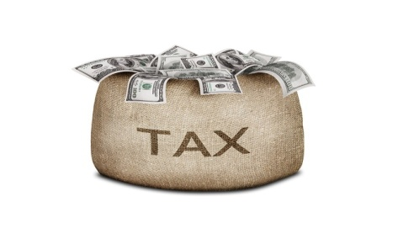

Cross utilization of Input Tax Credit
TAXABLE PERSON
A
Inward supply
C
Outward Supply
CGST Rs 10
SGST Rs 10
IGST Payable Rs 25
Rs 10
CGST
Rs 10
IGST
SGST

Slide 24
Place of Supply - Significance
Determining
  whether supplies are intra-state or inter-state /inter-national
  which tax to pay – CGST & SGST or IGST
Achieving the objective of destination based taxation
  Tax is paid at the point of origin. However, it has to reach consumption point
  ITC of IGST allowed to buying taxpayer in destination State
Notes:
Place of supply is a very important limb of GST and correct determination of POS is a must in order to ensure that tax moves to the place where supply is consumed.

Slide 25


Registration
Compulsory Registration for Each State where business situated
Option to take multiple registration for each business vertical within same state

Slide 26
Registration (contd.)
Liability to be registered
  Every person who is registered under existing indirect laws being subsumed in GST
  Every person whose turnover in a year exceeds Rs. 20 lakhs ( Rs. Ten lakhs for special category states)
  Voluntary registration permitted even if no liability.

Slide 27
  Mandatory Registration
  (irrespective of threshold)
  Persons making inter-State taxable supply
  Persons required to pay tax under reverse charge
  Casual and non-resident taxable persons
  E-Commerce operator /Those required to collect TDS
  Persons supplying goods through e-commerce operator
  Persons making supplies on behalf of a registered taxable person
  Input Service Distributer
  Every person supplying online information and data base access or retrieval services from a place outside India to a person in India, other than a registered person

Slide 28
Registration… (contd.)
Registration ( GSTIN)to be granted State-wise.
PAN mandatory for GSTIN (except for NRTP- here Passport)
Separate registration permitted for multiple business verticals in a State.
  Registration deemed to be granted if objection by way of Notice is not communicated within the time of 3 common working days.

Slide 29
Assessment and Scrutiny
Self assessment
Provisional assessment request of tax payer
    Tax payer if unable to determine tax rate or value, may request for provisional assessment. Dept shall not suo moto assess provisionally
Assessment of non-filer even after service of notice
    Best judgement
    Withdrawn if valid return furnished within 30 days of order
Assessment of un-registered person
Summary assessment
Scrutiny of return
Notes:
GST is based on self assessment. Taxpayer shall himself assess, file returns and pay GST. If the tax payer is unable to assess due to non availability of some information, he may request for provisional assessed. Govt will NOT ASSESS suo-moto. Govt will assess only in case of non-filers or unregistered persons. Summary assessment is done when

Slide 30
Returns Process under GST

Slide 31
Why Returns?
  Means of compliance verification
  Mode for transfer of information to tax administration
  To declare tax liability for a given period
  Providing necessary inputs for taking policy decision
Notes:
Can I say Businesses are not supposed to bear any tax; They collect tax on behalf of the govt, handover the same to govt; They are the partners of the govt in that regard.
In Customs where transaction level details are fed, no returns are filed; Here- one there is periodic tax payments ; second invoice feeding is also periodic; Infact interface itself is periodic ; thirdly not all invoices will be fed- only B2B and large B2C;

Slide 32
Features of Tax Returns in GST
  Based on transactions – Invoice based
  Designed for system based matching of Input Tax Credit and other details (import, export etc.)
  Auto-population from details of outward supplies
  Auto-reversal of ITC in case of mismatch
  Concepts of ledgers – cash, ITC and liability
  No revised returns – changes through amendments rectifications and reported in the return for the month in which error detected to original details
Notes:
Transaction invoice based information feeding and auto-population, auto-reversal and matching of information are the key hallmark of the returns system

Slide 33
GSTR1
GST Returns:
  Statement of Outward Supplies
    What information?
    Basic details To be filed by 10th of the next month- can be easily done by a computer
    Invoice level details ; GSTIN of recipient
    Invoice details – Number, date, HSN/SAC, ….Value, Taxable value…. POS
    Tax – IGST, CGST, SGST/UTGST – Rate and Tax amount
  What is not required to be uploaded?
    Invoice level information for B2C invoice < Rs. 2.5 lacs
    Consolidated information of all B2C supplies sufficient
    HSN/SAC ….. < Rs.1.5 crore
Notes:
GSTIN of the recipient in respect of each invoice; Huge implication; All B2B invoices- even if of one rupee, GSTIN number will have to be fed otherwise ITC is gone; Business practices need to be changed; Software need to be realigned; A company in different states will have different GSTIN so they would need to feed invoice level details for inter-company transfers;

Slide 34
GST Returns:
GSTR 2
Information Flow for auto-population/ self feeding
TCS/ TDS
GSTR1s of the suppliers
GSTR-6A
ISD
GSTR 2
To be Fed by Taxpayer
  Reverse Charge receipts from unregistered supplies
  Imports
GSTR 5
Non Resident TP
Notes:
GSTR 2 is an very important documents; Most of the data is autopopulated

Slide 35
GSTR 3
GST Returns:
Auto-populated based on GSTR-1 and GSTR-2
Outward Supplies
  All B2B inter and intra state supplies
  All B2C inter-State supplies above the value of Rs. 2.5 lacs
  Exports
  Revision of tax of previous periods
Inward Supplies
  Inter and intra state supplies received
  Imports
  Amendment to tax of previous periods
  Credit to ITC Ledger

Slide 36
Standardised forms/ certificates
GST Returns:
Form GSTR-1 -Details of outward supplies of taxable goods or services effected
Form GSTR-1A Details of outward supplies as added, corrected or deleted by the recipient
Form GSTR-2 Details of inward supplies of taxable goods and/or services claiming input tax credit
Form GSTR-2A Details of inward supplies made available to the recipient on the basis of FORM GSTR-1 furnished by the suppliers
GSTR-3 Monthly return on the basis of finalization of details of outward supplies and inward supplies
GSTR-3A Notice to a registered taxable person who fails to furnish return

Slide 37
Standardised forms/ certificates (contd.)
GST Returns:
Form GSTR-4 Quarterly Return for compounding Taxable persons
Form GSTR-4A Details of inward supplies made available to the recipient registered under composition scheme on the basis of FORM GSTR-1 furnished by the supplier
Form GSTR-5 Return for Non-Resident foreign taxable person
Form GSTR-6 ISD return
Form GSTR-6A Details of inward supplies made available to the ISD recipient on the basis of FORM GSTR-1 furnished by the supplier
Form GSTR-7 Return for authorities deducting tax at source
Form GSTR-7A TDS Certificate

Slide 38
Standardised forms/ certificates (contd.)
GST Returns:
Form GSTR-8 Details of supplies effected through e-commerce operator and the amount of tax collected
Form GSTR-9 Annual return
Form GSTR-9A Simplified Annual return by Compounding taxable persons registered under section 8
Form GSTR-9B Reconciliation Statement
Form GSTR-10 Final return
Form GSTR-11 Details of inward supplies to be furnished by a person having UIN

Slide 39
Correction in returns
GST Returns:
No Revision of returns
  As per the return taxes have already been paid and fund transfers already settled
  No significance as the basis now is individual transaction
All changes through rectifications reported in subsequent returns
If an invoice has been left out in GSTR-1 or GSTR-2 : can be uploaded in subsequent returns but to pay interest for any tax not paid on this account
If any invoice has been wrongly entered but remains unmatched – can be amended in subsequent returns

Slide 40
Correction in returns
GST Returns:
Post transaction changes to be done through debit or credit notes
Other details like B2C supplies can be amended in subsequent returns
Delayed uploading coupled with payment of interest
All changes, credit or debit notes to be carried out before September of the next financial year
  To enable any auto-reversal before Annual Return

Slide 41
Annual Return
GST Returns:
Annual summary of all transactions
Accounts to be certified by Chartered Accountant etc. if turnover more than Rs. 2 Crore
Personal Details
Details of Expenditure
  Purchases – goods/services – intra/inter state
  Imports
Details of Income
  Supplies – goods/services – intra/inter state
  Exports
Not to be filed by ISD, TDS Deductor, Casual Taxpayer, and Non resident taxpayer

Slide 42
First and Final Returns
GST Returns:
First Return
  Required when the liability to register and pay tax arose before grant of registration
Final Return
  On closure of business
  Reversal of credit on goods in stock

Slide 43
Refunds
Time limit for claiming refund enhanced 2 years from the relevant date.
Refund of Input tax Credit allowed in case of exports or where the credit accumulation is on account of inverted duty structure.
Refund shall be granted within 60 days from the date of receipt of application.
In case of refund claim on account of exports, 90% of the claim can be given immediately within seven days on provisional basis.
No need to furnish evidence against unjust enrichment if the refund claim is less than Rs. 2 lakhs. Self-certification would suffice.
Interest payable after 3 months from the date of receipt of application till the date of refund.

Slide 44
Advance Rulings
An applicant can apply for advance ruling even before taking up a transaction (proposed supply of goods or services) or in respect of a supply which is being undertaken.
  The only restriction is that the question being raised is already not pending or decided in any proceedings in the case of applicant.
Advance ruling to be issued within 90 days.
Advance ruling shall be binding on concerned officer or jurisdictional officer in case of applicant and only on the applicant
Advance ruling to continue unless there is a change in law or facts.

Slide 45
Issues on which ruling can be asked?
Classification
Applicability of a notification
Determination of time and value of supply
Admissibility of input tax credit of tax paid or deemed to have been paid
Determination of the liability to pay tax on any goods or services under the Act
Whether applicant is required to be registered under the Act;
Whether any particular thing done by the applicant with respect to any goods or services amounts to or results in a supply of goods or services

Slide 46
Transitional Provisions
Existing taxpayers to be issued Provisional Registration valid for 6 months (extendible)
  Upon furnishing of prescribed information, final RC to be granted
Cenvat credit/VAT carried forward in return allowed as ITC under GST
Un-availed Cenvat/VAT credit on capital goods, not carried forward in return, shall also be allowed as ITC under GST
Eligible duties and taxes in respect of inputs held in stock permissible as credit to registered persons

Slide 47
Transitional Provisions
Eligible duties and taxes in respect of inputs held in stock available as credit to taxable person switching over from compounding
Transitional credit available generally only if both laws permit and invoice is not more than 12 months old
No tax payable on goods removed/despatched earlier but returned within 6 months after the introduction of GST
Proceedings under earlier law to be conducted under old law

Slide 48
Role of GSTN: The IT Backbone of GST
  70 to 80 Lakhs taxpayers;
  260 to 300 Crores B2B invoice data per month
  More than 120,000 tax officials to work
  Monthly filing of returns
  Credit of ITC
  Creation of Business Intelligence reports and Analytics
  Both Central and States Tax Departments
Strong IT Infrastructure
Independent
Flexibility of Pvt Sector
Strategic Control of Govt
Notes:
Estimated number of taxpayers
Average number of B2B invoices: 400 (based on data from States collecting invoice data)

Slide 49
GSTN
  Section -25 (section has changed under the new Company Act), non-Government, Private Limited company
  Provide common Registration, Return filing and e-Payment services to the taxpayers
  Ensure integration of the GST Common Portal with existing tax administration systems of Central / State Governments and other stakeholders
  To run the clearing-house mechanism for IGST amongst c Centre and s States
  Provide Analytics and Business Intelligence to tax authorities
  Carry out research, study best practices and provide training to the stakeholders
Notes:
Why GSTN was created

Slide 50
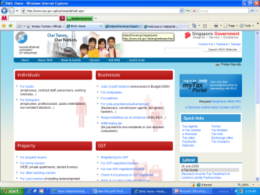
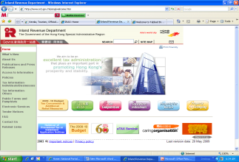
GST IT Strategy
Harmonization of Business Processes and Formats
Autonomy of back-end systems of States and Centre
Common & Shared
IT Infrastructure
IT
Interfaces
Centre/States
Tax IT Systems
Core Services
  Registration
  Returns
  Payments
Helpdesk support
Information on Inter-State supply and cross-credit utilization
Analytics
IGST Settlement
Non-Statutory Functions
Statutory Functions
Approval of Registration
Assessment
Refunds
Audit and Enforcement
Adjudication
Internal workflows to support above functions
Recovery
Analytics and BI
Notes:
Division of Frontend and Backend work.
Frontend: Common for all Tax Authorities, thus only one interface for taxpayers
Backend: Separate for each tax authority to run backend applications which are statutory in nature

Slide 51

GST Ecosystem
GST IT Strategy
Tax Authority
State / Centre Tax
IT Systems
Interface
GSTN IT Systems
Taxpayer
State/Centre Portal
GST Common Portal
API
Interface
State /
Centre
Database
Common
Portal
Database
State/ Centre
Application
GST Application
API Interface
Accounting Agencies & Treasuries
API Interface
Network of Banks & RBI
Notes:
Flow of information between GST Portal and Tax Authority System/Bank/Accounting Authorities

Slide 52
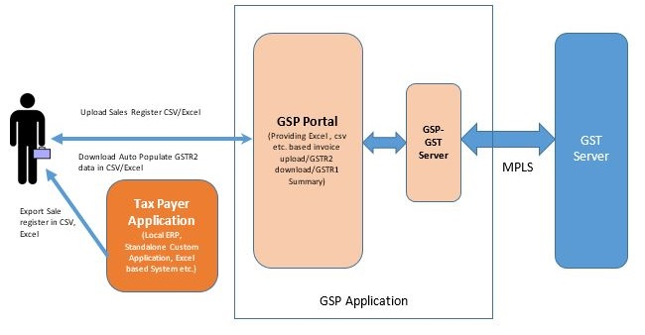
GST SUVIDHA PROVIDER (GSP)

Slide 53
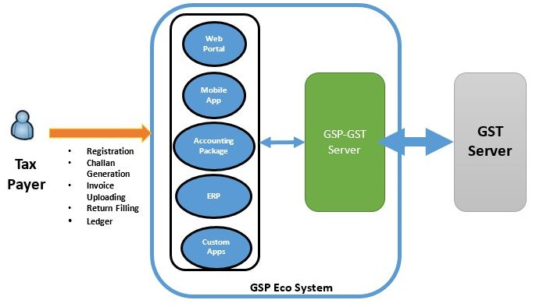
GSP Ecosystem

Slide 54
Resource Material
CGST /IGST/ UTGST Bills
Nine Rules on Valuation, Compensation, Returns, Registration, Composition, Invoice, Payment, Refund, Transition
Various Formats of returns/ registration
FAQs on GST
Migration
  GSTN FAQs on migration
  FAQs on Migration to GST by CBEC
  Step by Step guide to taxpayers
  Migration PPT

Slide 55
Resource Material- Links
http://www.cbec.gov.in/htdocs-cbec/gst/gst
http://www.cbec.gov.in/htdocs-cbec/migration-to-gst/migration-to-gst .....for migration related information
https://www.gst.gov.in/
http://www.gstn.org/
  http://tutorial.gst.gov.in

Slide 56
Help lines
www.gst.gov.in
  Helpline number: 0124-4688999
  helpdesk@gst.gov.in
www.aces.gov.in : for migration of existing assessees and getting provisional ID & Password
cbecmitra.helpdesk@icegate.gov.in :for migration issues
  Helpline toll free number: 1800-1200-232
CBEC GST Mobile App at Google Play Store

Slide 57
THANK YOU

